Slide 1
Predicting Diabetes Risk
Using Machine Learning
A Comparative Analysis of Nine Supervised Classifiers
on the CDC BRFSS 2015 Health Indicators Dataset
AUTHORS
Yaswanth Moapda · Srujith Borra · Uday Ankam
CSP 571 — Machine Learning · Spring 2026
70,692
9
0.827
Survey Records
ML Classifiers
Best AUC

Slide 2
INTRODUCTION
Background & Research Questions
Motivation
Research Questions
37M+
RQ1
Can survey-based features alone achieve clinically meaningful diabetes-prediction accuracy?
Americans have diabetes [CDC, 2022]
~25%
RQ2
Among 9 classifiers spanning different inductive biases, which yields the best discrimination?
remain undiagnosed until complications develop
RQ3
→ Need: Low-cost, scalable screening using survey data alone, without lab tests.
Does non-linear modeling improve over a linear baseline — and what does that imply?
2 / 10

Slide 3
DATASET
Dataset & Preprocessing
70,692
1,635
67,920
47,544 / 20,376
Raw Records
Duplicates Removed
After Balancing
70/30 Split
Predictors (21)
Preprocessing Pipeline
Binary (14): HighBP, HighChol, Smoker, Stroke, HeartDisease, PhysActivity, Fruits, Veggies, HvyAlcohol, AnyHealthcare, NoDocbcCost, DiffWalk, Sex, CholCheck
Continuous (7):
BMI, GenHlth, MentHlth, PhysHlth, Age, Education, Income — all z-score standardized
✔ Duplicate removal (1,635 rows) — prevents data leakage
✔ Class balancing (50/50, 67,920 rows) — eliminates majority bias
✔ Factor encoding (14 binary features)
✔ Z-score standardization (7 continuous features)
✔ Stratified 70/30 train-test split
3 / 10

Slide 4
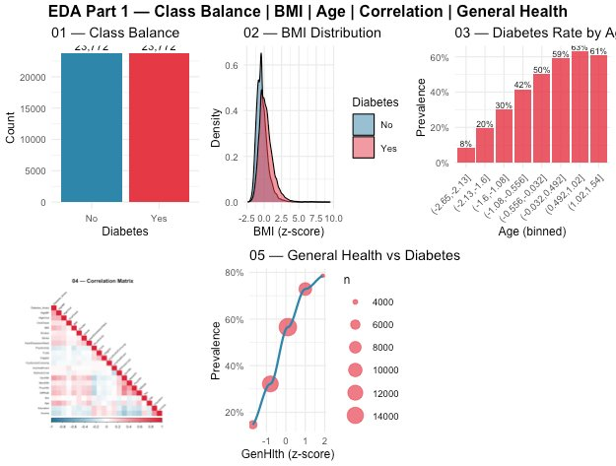
EDA — PART 1
Exploratory Data Analysis — Univariate & Correlation
Class Balance
Perfect 50/50 (23,772 each) → unbiased baseline
BMI
Clear right-shift for diabetic group → adiposity link
Age
Prevalence rises 8% → 61% across age groups
Correlation
Top: GenHlth, BMI, Age, HighBP. No |r| > 0.5
General Health
Near-perfect monotonic link → strongest signal
4 / 10

Slide 5
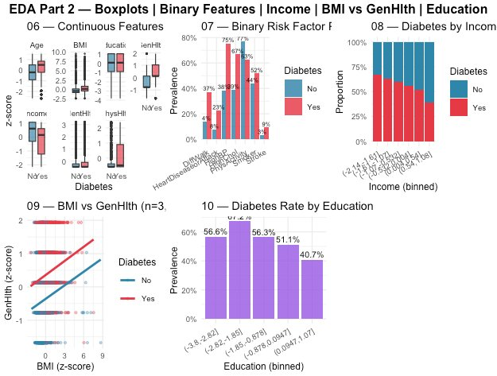
EDA — PART 2
Exploratory Data Analysis — Bivariate Patterns
Boxplots
All continuous features show group differences
Binary Features
HighBP gap: 67% vs 37% — largest discriminator
Income
Clear socioeconomic gradient → not a noise variable
BMI vs GenHlth
Diabetic cluster: high BMI + poor health
Education
Prevalence: 56.6% (low) → 40.7% (high)
5 / 10

Slide 6
METHODOLOGY
Model Selection — Nine Classifiers
Models span hypothesis classes motivated by EDA findings
Logistic Regression
Lasso (glmnet)
Decision Tree
Parametric · Linear
Parametric · Regularized
Tree-based · Interpretable
Binomial GLM · Full data
alpha=1, λ by 5-fold CV
rpart, cp=0.001, depth=6
Random Forest
GBM
XGBoost
Tree-based · Bagging
Tree-based · Boosting ⭐
Tree-based · Reg. Boosting
300 trees, mtry=4
500 trees, depth=3, η=0.05
400 rounds, η=0.05, depth=4
SVM
Neural Network
k-NN
Kernel · Margin-based
Non-parametric · Deep-ish
Distance · Local
Linear, C=1 · 10% subsample
8 hidden, decay=0.01 · 10%
k=21 · 10% subsample
⚠ SVM, Neural Net, k-NN trained on 10% subsample (4,756 rows) due to compute constraints — results are lower bounds.
6 / 10

Slide 7
RESULTS
Model Performance — Test Set (n = 20,376)
Model | Acc. | Sens. | Spec. | Prec. | F1 | AUC
GBM ⭐ | 74.9% | 78.9% | 70.8% | 73.0% | 0.758 | 0.827
XGBoost | 74.8% | 78.6% | 71.0% | 73.1% | 0.758 | 0.826
Logistic | 74.6% | 76.7% | 72.4% | 73.5% | 0.751 | 0.820
Lasso | 74.5% | 76.8% | 72.3% | 73.5% | 0.751 | 0.820
SVM | 74.4% | 76.3% | 72.6% | 73.5% | 0.749 | 0.818
RandomForest | 74.1% | 78.5% | 69.7% | 72.2% | 0.752 | 0.814
NeuralNet | 72.7% | 74.9% | 70.5% | 71.7% | 0.733 | 0.798
DecisionTree | 71.8% | 73.5% | 70.2% | 71.1% | 0.723 | 0.790
kNN | 68.9% | 69.1% | 68.7% | 68.8% | 0.690 | 0.755
⭐ GBM & XGBoost lead (AUC ≈ 0.83); Logistic Regression follows closely (AUC=0.820) → relationship is largely linear.
7 / 10

Slide 8
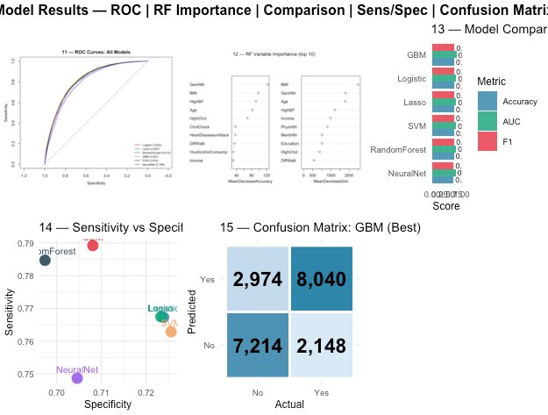
RESULTS
ROC Curves, Variable Importance & Confusion Matrix
ROC — Plot 11
Importance — Plot 12
Confusion Matrix — GBM
GBM dominates curve. All 9 beat random baseline. Boosting > bagging > linear > tree > kNN.
GenHlth & BMI top — matches EDA exactly. Validates feature signal.
TP=8,040 · TN=7,214 · FP=2,974 · FN=2,148. Lowest FN of all 9.
8 / 10

Slide 9
DISCUSSION
Key Findings
01 GBM & XGBoost lead — but margin is small
02 Linear models are surprisingly competitive
AUC 0.827 / 0.826. Sequential boosting handles class overlap best, but XGBoost's regularization adds little here.
Logistic Regression AUC=0.820 — only 0.007 below GBM. Implies feature-outcome relationship is largely linear.
03 Lasso retained all 21 features (λ ≈ 0)
04 k-NN underperforms — curse of dimensionality
Cross-validated regularization confirmed no redundancy — empirical validation of EDA finding.
21 features create sparse neighborhoods; distance-based methods degrade. Classical theoretical limitation.
05 EDA findings validated by RF importance
06 GBM is best for clinical deployment
GenHlth, BMI, Age, HighBP, Income — top 5 in both EDA and RF importance scores. Models learn real patterns.
Highest sensitivity (78.9%) and lowest false negatives (2,148) — critical for screening applications.
9 / 10

Slide 10
Conclusions
Yaswanth Moapda
Srujith Borra
Uday Ankam
Summary
1. Survey-based diabetes prediction achieves AUC ≈ 0.83 with only behavioral features — no lab tests required.
2. GBM is the recommended deployment model (highest sensitivity, lowest FN).
3. Logistic Regression is a viable alternative where interpretability is required (AUC gap = 0.007).
4. GenHlth, BMI, Age, HighBP, Income — predictors align with established epidemiology.
9 Models
Compared on test set
0.827
Best AUC (GBM)
74.9%
Limitations & Future Work
Best Accuracy
· SVM / NN / k-NN trained on 10% subsample — full-data training needed
· 50/50 class balance ≠ ~14% population prevalence — recalibration required
78.9%
· Self-reported features carry measurement & recall bias
Best Sensitivity
· Future: ensemble stacking, threshold tuning, recent BRFSS cycles
CSP 571 | Spring 2025 | Dataset: UCI ML Repository — CDC BRFSS 2015

